Slide 1
MGB235 Monitoring and Managing Operational Performance
Topic 10 Inventory Management
Chapter 12:
Stevenson, W.J. (2021) 14th ed. Operations Management, McGraw Hill, New York, NY.
Chapter 13
Russell, Roberta S., and Taylor III, Bernard W. (2017) Operations and supply chain management, 9th ed., Hoboken: NJ.

Slide 2
What is inventory?
The different types of inventory;
Inventory management and control;
Inventory management systems
Methods for prioritizing the importance of inventory items;
Monitoring and controlling independent demand using fixed order quantities - FQS;
http://www.smh.com.au/business/retail/dick-smith-was-selling-too-many-products-former-chairman-phillip-cave-tells-court-20161004-gruc7i.html
Learning Objectives
2

Slide 3
What Is Inventory?
Stock of items kept to meet future demand – based on forecasts – applies to both goods and services.
Independent-demand items
  Items that are ready to be sold or used
Is spare capacity another form of inventory?
Inventories are a vital part of business: (1) necessary for operations and (2) contribute to customer satisfaction
  A “typical” firm has roughly 30% of its current assets and as much as 90% of its working capital invested in inventory

Slide 4
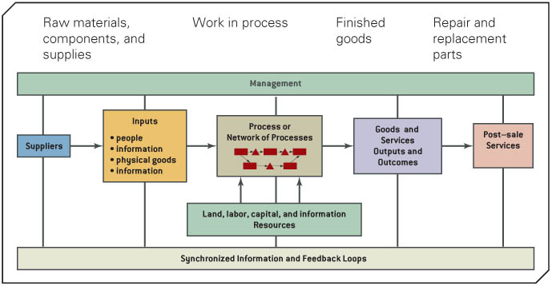
Role of Inventory in the Value Chain
4

Slide 5
Quality Management in the Supply Chain
As one key aspect of quality management customers usually perceive quality service as availability of goods they want when they want them
Inventory must be sufficient to provide high-quality customer service in QM
But this raises the question of how does one decide on the trade off between cost and quality?
13-5

Slide 6
The Different Types of Inventory
Types of Inventory
Raw Materials, component parts, subassemblies, and purchased parts supplies (MRO): inputs to manufacturing and service-delivery processes.
Work-in-process (WIP) inventory: partially finished products in various stages of completion that are awaiting further processing.
Finished goods inventory (FG): completed products ready for distribution or sale to customers.
Items being transported
6

Slide 7
The Different Types of Inventory
Basic Inventory Concepts
Pipeline inventory: inventory that has been ordered but not yet received and is in transit.
Anticipation inventory: built up during the off-season to meet future estimated demand.
7

Slide 8
The Different Types of Inventory
Basic Inventory Concepts
Cycle inventory (order or lot size inventory): inventory that results from purchasing or producing in larger lots than are needed for immediate consumption or sale.
Safety stock inventory: an additional amount of inventory that is kept over and above the average amount required to meet demand.
8

Slide 9
Inventory Management
Inventory is any asset held for future use or sale.
The expenses associated with financing and maintaining inventories are a substantial part of the cost of doing business (cost of goods sold).
Inventory Management involves planning, coordinating, and controlling the acquisition, storage, handling, movement, distribution, and possible sale of raw materials, component parts and subassemblies, supplies and tools, replacement parts, and other assets that are needed to meet customer wants and needs.
9

Slide 10
Objectives of Inventory Control
Inventory management has two main concerns:
  Level of customer service
    Having the right goods available in the right quantity in the right place at the right time
  Costs of ordering and carrying inventories
    The overall objective of inventory management is to achieve satisfactory levels of customer service while keeping inventory costs within reasonable bounds
      Measures of performance
      Customer satisfaction
        Number and quantity of backorders
        Customer complaints
      Inventory turnover
  Copyright ©2021 McGraw-Hill Education. All rights reserved. No reproduction or distribution without the prior written consent of McGraw-Hill Education.
12-10

Slide 11
Inventory Control (Management) Systems
Purpose of inventory management
  how many units to order
  when to order
Continuous system (fixed-order-quantity)
  constant amount ordered when inventory declines to predetermined level
Periodic system (fixed-time-period)
  order placed for variable amount after fixed passage of time

Slide 12
Inventory Management Systems
Characteristics of Inventory Systems
Number of items: each item is identified by its stock-keeping unit (SKU) or barcode
A stock-keeping unit (SKU) is a single item or asset stored at a particular location.
Maintaining data integrity on thousands of SKUs is difficult but must be done.
Applies predominantly to goods – services pose different issues
12

Slide 13
Inventory Management Systems
Nature of demand:
  Independent demand: demand is unrelated to the demand for other SKUs and must be forecast.
  Dependent demand: demand directly related to the demand of other SKUs and can be calculated without needing to be forecast.
  Deterministic demand is when uncertainty is not included in its characteristics.
  Stochastic demand: incorporates uncertainty by using probability distributions (for information only).
  Static demand: stable demand.
  Dynamic demand: varies over time (for information only).
13

Slide 14
Inventory Management Systems
Characteristics of Inventory Systems
Number of time periods in planning horizon: short or long planning horizon such as days, weeks, months, quarters, and years.
Size of time periods: hours, days, weeks, months, quarters.
Lead time: time between placement of an order and its receipt.
14

Slide 15
Inventory Management Systems
Characteristics of Inventory Systems
Stockouts: inability to satisfy demand for an item. When a stockout happens the item is either back-ordered or a sale is lost.
Backorder occurs when a customer is willing to wait for an item.
Lost sale occurs when the customer is unwilling to wait and purchases the item elsewhere.
Perishability: SKU deteriorates or becomes obsolete after a certain period of time. Examples ?
15

Slide 16
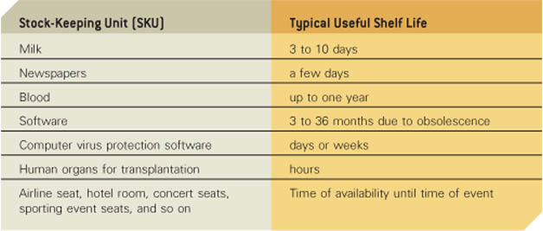
Examples of Perishable SKUs
(Collier, & Evans, 2007, Exhibit 12.2)
16

Slide 17
Inventory Management Systems
Data Accuracy
Inventory Management Infrastructure
Cycle Counting: system for repetitive physical counting of inventory throughout the year.
Purpose of cycle counting is to check on the accuracy of actual physical inventory and improve data integrity.
17

Slide 18
Inventory Management Systems
Managing Inventories and Data Accuracy
Inventory Management Infrastructure
Telematic diagnostic and monitoring systems: two-way wireless communication capabilities between equipment and its external environment.
Radio frequency identification (RFID) tags (chips) embedded in packaging, products or shipping containers to constantly update the status of the SKU.
https://www.youtube.com/watch?v=gEQJxNDSKAE
18

Slide 19
Prioritizing the importance of inventory items
Inventory managers deal with two fundamental decisions:
When to order items from a supplier or when to initiate production runs, if the firm makes its own items, and
How much to order or produce each time a supplier or production order is placed.
19

Slide 20
Prioritizing the importance of inventory items
Inventory Management Decisions & Costs
Four categories of inventory costs:
    Ordering or setup costs
    Inventory-holding costs
    Shortage costs
    Unit cost of the stock-keeping units (SKUs)
20

Slide 21
Prioritizing the importance of inventory items
Inventory Management Decisions & Costs
Ordering costs (setup costs): incurred as a result of the work involved in placing purchase orders with suppliers or configuring tools, equipment, and machines within a factory to produce an item. C_{o}
Inventory-holding costs (inventory-carrying costs): the expenses associated with carrying inventory. C_{c}
Shortage costs (stockout costs): the costs associated with a stock keeping units (SKU) being unavailable when needed to meet demand.
Unit cost (SKU): price paid for purchased goods or the internal cost of producing them.
21

Slide 22
Prioritizing the importance of inventory items
ABC Inventory Analysis
Inventory Management Infrastructure
ABC inventory (Pareto) analysis gives managers useful information to identify the best methods to control each category of inventory
A vital few SKUs represent a high percentage of the total dollar inventory value.
22

Slide 23
Prioritizing the importance of inventory items
ABC Inventory (Pareto) Analysis
“A” items account for a large dollar value but relatively small percentage of total items. 10% of items yet 80% of total dollar usage.
“C” items account for a small dollar value but a large percentage of total items; can be managed using automated computer systems. 50% to 60% of items yet about 5% to 10% total dollar value.
“B” items are between A and C (30% of items but only 15% of total dollar usage).
23

Slide 24
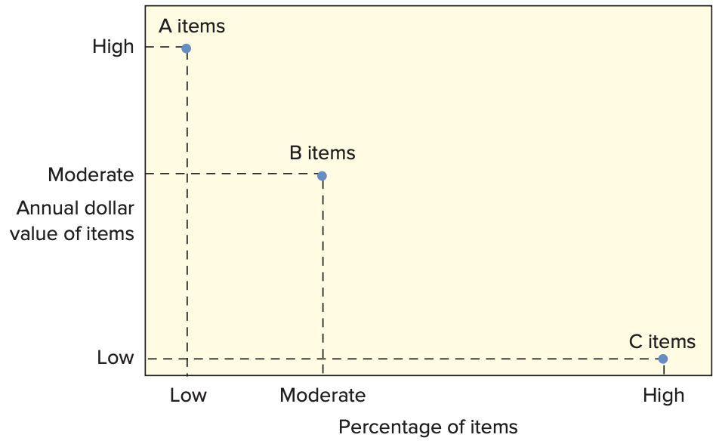
ABC Classification System
A-B-C approach
  Classifying inventory according to some measure of importance, and allocating control efforts accordingly
  A items (very important)
    10 to 20 percent of the number of items in inventory and about 60 to 70 percent of the annual dollar value
  B items (moderately important)
  C items (least important)
    50 to 60 percent of the number
    of items in inventory but only
    about 10 to 15 percent of the
    annual dollar value
  Copyright ©2021 McGraw-Hill Education. All rights reserved. No reproduction or distribution without the prior written consent of McGraw-Hill Education.
12-24

Slide 25
Fixed Order Quantity System
Fixed Quantity Systems (FQS): the order quantity or lot size is fixed; the same amount, Q, is ordered every time.
The process of triggering an order is based on the inventory position.
Inventory Position (IP): on-hand quantity (OH) plus any order placed but have not arrived (scheduled receipts, or SR), minus any backorders (BO).
IP = OH + SR — BO
25

Slide 26
Fixed Order Quantity System
Fixed Quantity System - when to order
When inventory falls at or below a certain value a new order is placed; This is called the reorder point, r
Reorder point depends on the lead time and nature of demand—oftentimes, the reorder point is selected using the average demand during the lead time r = d xL
Where d is average demand per unit of time and L
is the lead time expressed in the same unit of time.
26

Slide 27
Reorder Point (R) Example
Demand = 10,000 gallons/year
Store open 311 days/year
Daily demand = 10,000 / 311 = 32.154 gallons/day
Lead time = L = 10 days
R = dL = (32.154)(10) = 321.54 gallons
13-27

Slide 28
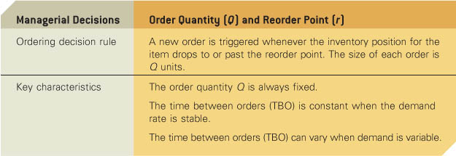
Interim Summary of Fixed Quantity System (FQS)
Fixed (Order) Quantity System
But what is the Economic Order Quantity (Q)?
28

Slide 29
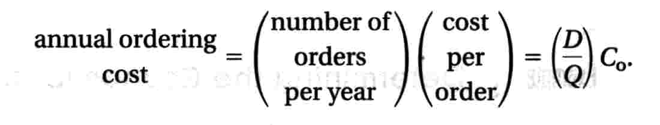
Fixed Order Quantity System
The Economic Order Quantity (EOQ) model is a classic
economic model developed in the early 1900s that minimize
total cost, which is defined as the sum of the inventory-holding
cost and the ordering cost:
D annual demand
C_{o} internal cost assessment e.g. from order placement to order receipt
Q number of units in the fixed order *
29

Slide 30
Fixed Order Quantity System
The Economic Order Quantity (EOQ) model is a classic
economic model developed in the early 1900s that minimize
total cost, which is defined as the sum of the ordering cost and the inventory-holding cost:
Cost of storing one unit in inventory (SKU) for the year (C_{c}), is given by C_{c} = I x C, where I is annual inventory-holding charge as a percentage of the unit cost of the inventory item C, and;
Q/2 is the average number of units of an SKU in inventory
30

Slide 31
Fixed Order Quantity System
Total Cost (TC) of Inventory Summary
C_{o} - cost of placing order D - annual demand
C_{c} - annual per-unit carrying cost Q - order quantity
C_{o}D
Q
Annual ordering cost =
C_{c}Q
2
Annual carrying cost =
But we don’t know the economic order quantity (Q)?
31

Slide 32
EOQ Cost Model (you don’t need to know how to derive Q)
Deriving Q_{opt}
Proving equality of costs at optimal point
C_{o}D
Q
C_{c}Q
2
TC = +
C_{o}D
Q
C_{c}Q
2
∂TC
∂Q
C_{o}D
Q²
C_{c}
2
=
= – +
2C_{o}D
C_{c}
C₀D
Q²
C_{c}
2
Q² =
0 = – +
2C_{o}D
C_{c}
2C_{o}D
C_{c}
Q_{opt} =
Q_{opt} =
You need to be able to apply the EOQ Model
Q* is the quantity that minimizes the total cost and is known as the economic order quantity.
13-32

Slide 34
Example: EOQ & simplified reorder point
A wholesaler of consumer electronics operates 52 weeks per year. The following information is for one of the Video Cassette Recorders that they stock and sell.
  Demand = 4500 units/year
  Ordering costs (C_{o}) = $40/order
  Holding costs (C_{c}) = $3/unit/year
  Number of weeks per year = 52 weeks
  Lead time = 2 weeks
34

Slide 35
Example: EOQ & simplified reorder point
Question and Solution
1. Using the fixed order quantity system to control inventory, compute the EOQ and state your ordering decision rules.
= 346.4 units
2. Compute the reorder point and state the order decision rule
Order decision rule: Place a new order for 346 units when the inventory position drops to or past the reorder point of 174¹ units.
35

Slide 36
Question and Solution
Compute the total annual cost: inventory holding cost plus the ordering cost:
TC = (346/2)*3 + (4,500/346)*40
= $519 + $519 = $1,038
36

Slide 37
Key Assumptions of the EOQ Model
Only a single item (SKU) is considered.
The entire order quantity (Q) arrives in the inventory at one time. No physical limits are placed on the size of the order quantity, such as shipment capacity or storage availability.
Only two types costs are relevant—order/setup and inventory holding costs.
No stockouts are allowed.
The demand for the item is deterministic and continuous over time. This means that units are withdrawn from inventory at a constant rate proportional to time. For example, an annual demand of 365 units implies a monthly demand of 365/12 and a daily demand of one unit.
Lead time is constant.
37

Slide 38
Fixed Order Quantity System - Alternatives
Fixed Period Systems
An alternative to a fixed order quantity system is a
fixed period system (FPS)—sometimes called a
periodic review system—in which the inventory
position is checked only at fixed intervals of time, T,
rather than on a continuous basis.
38

Slide 39
Fixed Order Quantity System - Alternatives
Single-Period Inventory Model
Applies to inventory situations in which one order is placed for a good in anticipation of a future selling season where demand is uncertain.
At the end of the period, the product has either sold out or there is a surplus of unsold items to sell for a salvage value.
Sometimes called a news-vendor problem, because newspaper sales are a typical example of the single-period inventory problem.
39

Slide 40
In the lecture we covered:
The different types of inventory;
Methods for prioritizing the importance of inventory items;
Inventory management systems;
Monitoring and controlling independent demand using fixed
order quantities – FQS.
40

